Slide 1
Directives

Slide 2
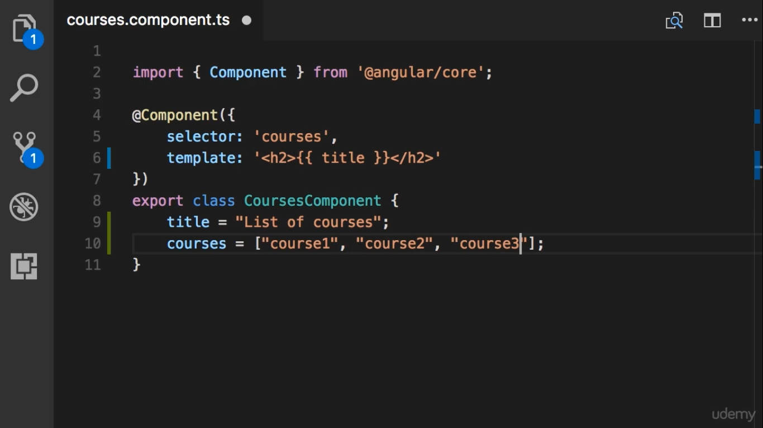

Slide 3
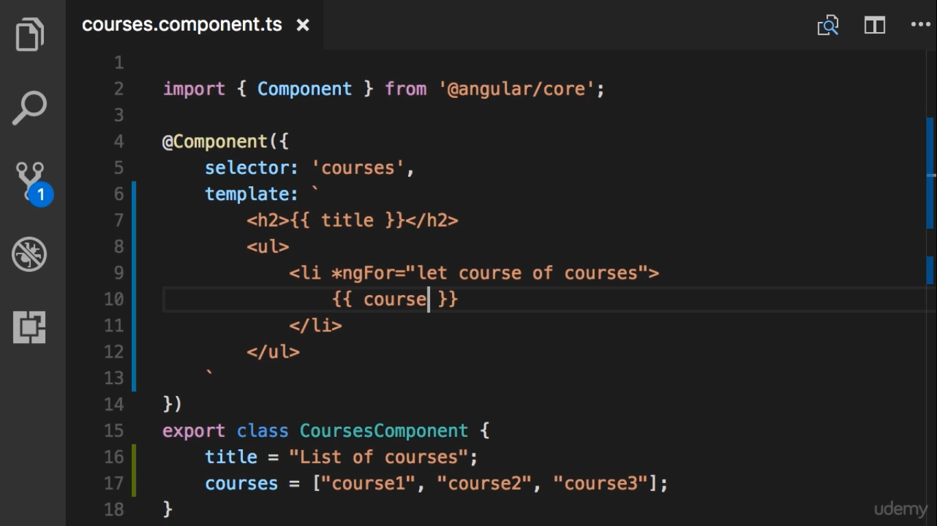
Use directives to manipulate the DOM

Slide 4
